Slide 1
Weisfeiler-Lehman Neural Machine for Link Prediction
Muhan Zhang and Yixin Chen, KDD 2017

Slide 2
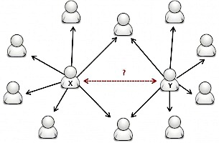
Link Prediction (LP) Problem
Given an incomplete network, predict whether two nodes are likely
to have a link.
Figure from the Internet
Applications:
Friend recommendation in social networks
Product recommendation in ecommerce
Reaction prediction in metabolic networks
Knowledge graph completion
...
Notes:
Given an incomplete network, link prediction, is to predict whether two nodes are likely to have a link. It has many applications such as ...

Slide 3

Link Prediction (LP) Problem
Notes:
Let’s see some concrete examples. This figure is a screenshot of facebook’s friend recommendation system. As we can see, it suggest the people you may know by counting the mutual friends you share with these people. This is a link prediction example in a social network.
( Given a person in a social network, link prediction aims to predict which people this person is most likely to connect to in order to help users establish connections.)

Slide 4
Link Prediction (LP) Problem
Notes:
The second example comes from Amazon’s product recommendation. When you buy a product, Amazon will recommend some items that are frequently bought together with this product. This is an example of link prediction in the user-product network.

Slide 5
Heuristic Methods for LP
Calculate a proximity score for each pair of nodes.
Notes:
The most widely used methods for link prediction are heuristic methods. A heuristic method predicts links by calculating a proximity score for each pair of nodes as their likelihood of having a link.
There are many very simple but effective heuristics for link prediction,Table 1 shows some popular ones. I will go over four representative ones with you.

Slide 6
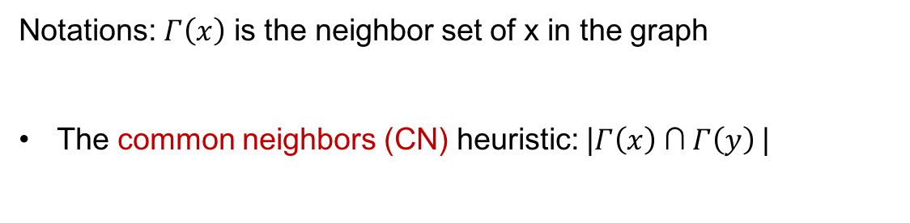
Heuristic Methods for LP
Notations: $Γ\left(x\right)$ is the neighbor set of x in the graph
The common neighbors (CN) heuristic: |$Γ\left(x\right)$ ∩$Γ\left(y\right)$|
x and y are likely to have a link
if they have many common neighbors.
x
y
Notes:
I will use Gamma(x) to denote the neighbor set of a node x in a graph.
The first one, called common neighbors heuristic, is just what is used in the Facebook example. It predicts links by counting the common neighbors of both x and y. It assumes that x and y are likely to be friends if they have many common friends.

Slide 7
Heuristic Methods for LP
The preferential attachment (PA) heuristic: |$Γ\left(x\right)$|$∙$|$Γ\left(y\right)$|
x prefers to connect to y if
y is popular.
x
y
First-order heuristic, only involves 1-hop neighbors.
Notes:
The second heuristic, called preferential attachment heuristic, predicts links using the product of x and y’s degrees. It assumes that x prefers to connect to y if y is popular. This is also a reasonable heuristic.
Both the common neighbors heuristic and the preferential attachment heuristic are first-order heuristics, since one only needs to know the 1-hop-neighbors of x and y in order to calculate the scores.

Slide 8
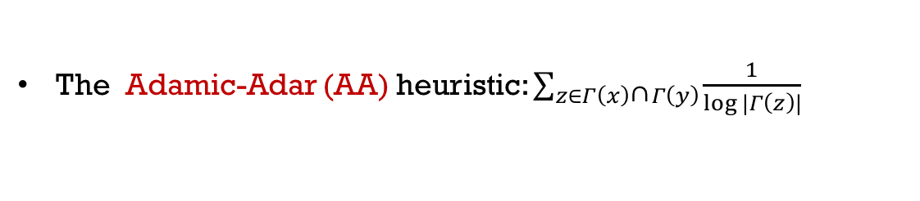
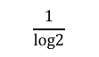
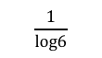
Heuristic Methods for LP
The Adamic-Adar (AA) heuristic: $\sum_{z∈Γ\left(x\right)\text{∩}Γ\left(y\right)}{\frac{1}{log⁡|Γ\left(z\right)|}}$
a
$$\frac{1}{log6}$$
Weighted common neighbors;
Popular common neigbhors contribute less.
x
y
$$\frac{1}{log2}$$
b
Second-order heuristic. Involves 2-hop neighbors of x and y.
Notes:
Now let’s see a second-order heuristic, the Adamic-Adar heuristic. Basically it is a weighted common neighbors in which a high-degree common neighbor such as a is weighted less than a low degree common neighbor such as b. It assumes that both x and y connecting to a is not surprising, since a also has many other connections. But x and y both connecting to b is informative, since b has no other connections. This is a second-order heuristic, since it involves up to 2-hop neighbors of x and y to compute the heuristic score.

Slide 9
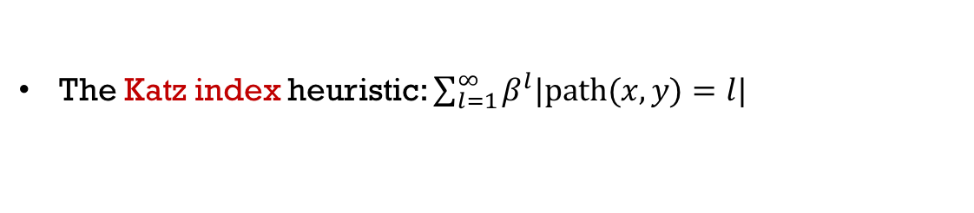
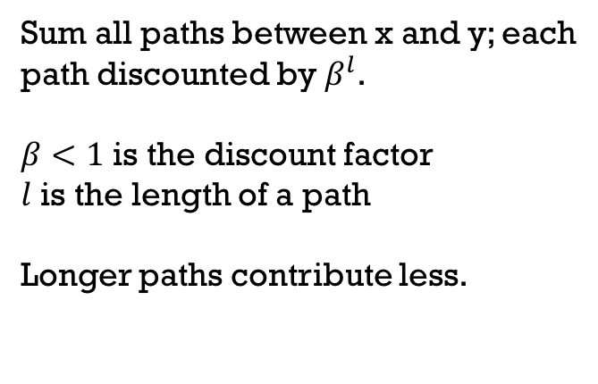
Heuristic Methods for LP
The Katz index heuristic: $\sum_{l=1}^{∞}{β^{l}|\text{path}(x,y)=l|}$
Sum all paths between x and y; each
path discounted by $β^{l}$.
$β<1$ is the discount factor
$l$ is the length of a path
Longer paths contribute less.
x
y
High-order heuristics; need to search the entire graph.
Notes:
Now let’s see a high-order heuristic, the Katz index. It sums all paths between x and y; each path is discounted according to its length. So a longer path is discounted more than short path. Katz index is a high-order heuristic, since one need to search the entire graph in order to find all paths between x and y.

Slide 10
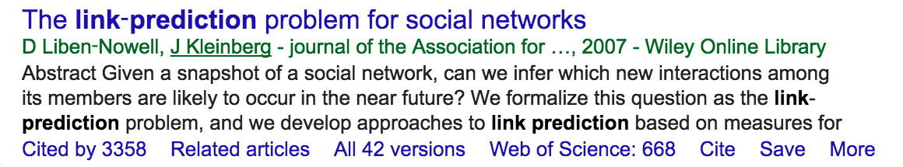
Problems of Heuristic Methods
There are over 50 different heuristics for LP.
Many new heuristics come out every year.
Problems:
No universally good heuristic. A heuristic may work well on a kind of networks, but poorly on others.
There are networks where no existing heuristics work well.
Notes:
There are over 50 different heuristics for LP, and relevant papers on designing new link prediction heuristics come out every year since Libon-Nowell and Jon Kleinberg first introduced the problem of link prediction.
However, the problems are, firstly, there is no universally good heuristic for link prediction, a heuristic may work well on some certain kinds of networks, but may perform poorly on others. The second problem is that there are some networks where no existing heuristic can perform well.

Slide 11
Problems of Heuristic Methods
AUC Performance of 10 heuristics on 6 networks
Observations:
A heuristic only performs well on certain networks.
On “power grid” and “router-level Internet”, no heuristic performs much better than random guess…
Linyuan Lu and Tao Zhou. 2011. Link prediction in complex networks: A survey. Physical A: Statistical Mechanics and its Applications.
Notes:
This table shows the AUC performance of 10 heuristics on 6 benchmark datasets from a survey paper. As we can see, there is no heuristic that can perform well on all networks. Moreover, all the methods perform poorly on the power grid network and the router-level Internet network. They are not much better than random guess… This may imply that no heuristics here really captured the link formation mechanisms of these two networks.

Slide 12
Problems of Heuristic Methods
The reasons:
Assume particular link formation mechanisms
Handcrafted graph features
Why not directly learn such features from the network?
Weisfeiler-Lehman Neural Machine (WLNM)
WLNM is a neural network model for link prediction which automatically learns graph features from links’ enclosing subgraphs.
Notes:
The reasons for heuristic methods’inconsistent performance are that they assume particular link formation mechanisms and can be seen as some hand-crafted graph features. So this motivates a question, since all heuristic methods predict links using hand-crafted graph features, can we directly learn such graph features from the network itself? This leads to the proposed method, WLNM, which is a neural network model for link prediction that automatically learns graph features from links’local enclosing subgraphs.

Slide 13
Weisfeiler-Lehman Neural Machine
Overall framework:
4
0 | 1 | 1 | 1
1 | 0 | 1 | 1
1 | 1 | 0 | 0
1 | 1 | 0 | 0
B
A
2
1
1
B
A
Extract
subgraphs
Graph
labeling
3
Data
encoding
Neural
network
C
0 | 0 | 1 | 0
0 | 0 | 1 | 1
1 | 1 | 0 | 0
0 | 1 | 0 | 0
D
C
4
2
0
D
1
3
Notes:
The figure illustrates the overall framework of Wlnm. Given a network, Wlnm first samples a set of positive links (illustrated as link (A, B)) and also a set of negative links (illustrated as link (C,D)) as training links, and then it extracts a local neighborhood subgraph for each link as the characteristic representation of this link.
After that, graph labeling methods are used to determine the vertex order of this enclosing subgraph. Then we construct an adjacency matrix using this vertex order. And finally, the (matrix, label) pairs are fed into a neural network to learn a link prediction model.

Slide 14
Subgraph Extraction
Overall framework:
4
0 | 1 | 1 | 1
1 | 0 | 1 | 1
1 | 1 | 0 | 0
1 | 1 | 0 | 0
B
A
2
1
1
B
A
Extract
subgraphs
Graph
labeling
3
Data
encoding
Neural
network
C
0 | 0 | 1 | 0
0 | 0 | 1 | 1
1 | 1 | 0 | 0
0 | 1 | 0 | 0
D
C
4
2
0
D
1
3
Notes:
Let’s first see how does WLNM extract subgraphs.

Slide 15
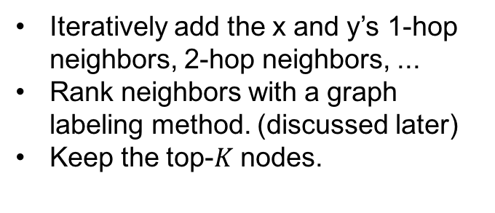
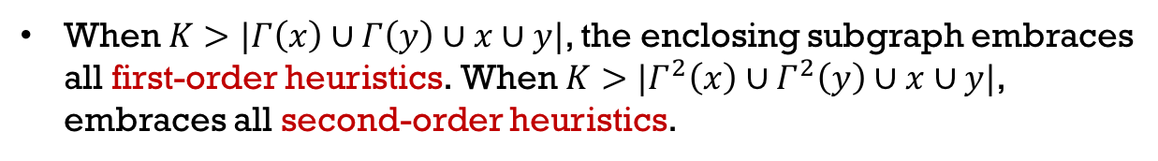
Subgraph Extraction
Enclosing subgraph extraction:
target nodes
1-hop neighbors
x
y
2-hop neighbors
3-hop neighbors
Iteratively add the x and y’s 1-hop neighbors, 2-hop neighbors, ...
Rank neighbors with a graph labeling method. (discussed later)
Keep the top-$K$ nodes.
The enclosing subgraph depicts the local pattern of a link.
When $K>|Γ\left(x\right)∪Γ\left(y\right)∪x∪y|$, the enclosing subgraph embraces all first-order heuristics. When $K>|Γ^{2}\left(x\right)∪Γ^{2}\left(y\right)∪x∪y|$, embraces all second-order heuristics.
Notes:
Given the target nodes x and y, we iteratively add their 1-hop neighbors, 2-hop neighbors, 3-hop neighbors and so on until the subgraph has more than K nodes. Then we rank these neighboring nodes using a graph labeling method, which will be discussed later. Finally, we keep the top-K nodes and construct an enclosing subgraph for the target link.
We can see that the enclosing subgraph actually depicts the local pattern of a link which may contain much information about whether this link is likely to exist. Moreover, as we increase K, the enclosing subgraph will gradually embrace all the information needed to calculate the first-order, second-order and high-order heuristics. For example, in this subgraph, it contains all the one-hop neighbors and two-hop neighbors of x and y, so we can calculate all the first-order and second-order heuristics based merely on this subgraph.

Slide 16
Graph Labeling
Overall framework:
4
0 | 1 | 1 | 1
1 | 0 | 1 | 1
1 | 1 | 0 | 0
1 | 1 | 0 | 0
B
A
2
1
1
B
A
Extract
subgraphs
Graph
labeling
3
Data
encoding
Neural
network
C
0 | 0 | 1 | 0
0 | 0 | 1 | 1
1 | 1 | 0 | 0
0 | 1 | 0 | 0
D
C
4
2
0
D
1
3
Notes:
Given the extracted enclosing subgraphs, we still need to represent them using some machine-readable data format. We choose to construct an adjacency matrix for each enclosing subgraph. To achieve this, we need to first determine the vertex ordering for this adjacency matrix. Here we use graph labeling methods.

Slide 17
Graph Labeling
Graph labeling for subgraph pattern encoding:
Defines an order for vertices.
Requirements:
label nodes according to their structural roles => WL
Should also keep the intrinsic directionality of the subgraph.
15
21
16
7
5
8
10
14
13
x
2
y
1
9
3
6
12
11
4
19
17
18
20
shows the intrinsic direction: the center is the target link; other nodes are added outward
Notes:
Graph labeling is a kind of algorithms that assign positive integer labels or colors to graph vertices, like this example. Intuitively, we have two requirements for the graph labeling method used here. Firstly, it should label the vertices according to their structural roles within a subgraph, that is to say, two nodes of two different subgraphs should have similar labels if and only if they have similar structural roles within their respective graphs. This is important for the machine learning models to read different subgraphs in a consistent order. And later we will show that Weisfeiler-Lehman algorithm an eligible one. The second requirement is, the graph labels should also keep the intrinsic directionality of the subgraph. This is because an enclosing subgraph is constructed by iteratively adding new nodes outward from the center. We can achieve this by, for example, letting nodes closer to the center have smaller labels than farther nodes. This way, we can encode the directionality information into the graph labels.

Slide 18
The Weisfeiler-Lehman Algorithm
[Weisfeiler and Lehman, 1968]
1
1
1
1,2
1,1
2
2
1
2
4
1
2,23
2,13
1,11
1,11
2
1
1
3
5
2,22
3
1,11
1,111
3,222
2
1
4
2,23
1,11
Notes:
So the graph labeling method we used is called Weisfeiler-Lehman algorithm,or WL, it labels vertices according to their structural roles. It first assigns initial color 1 to all the graph vertices. And then it constructs a signature string for each vertex by concatenating its own color and its neighbors’colors like this. After that, all the signature strings are compressed into new positive integer colors in lexical order. This process is repeated until the colors converge. The final colors encode the topological positions of the nodes in a graph. WL is widely used in graph isomorphism checking, and graph kernel designs. The struture-encoding property of WL makes it an eligible graph labeling algorithm that meets our first requirement.

Slide 19
The Weisfeiler-Lehman Algorithm
How to let WL colors encode the directionality?
Assign initial colors to nodes based on distance to the center;
Run classical WL on these initial colors.
4
3
21
15
3
16
2
7
2
2
10
5
2
8
3
14
x
x
x
y
y
3
y
13
1
2
1
1
2
9
2
3
2
6
2
12
2
11
2
4
3
19
3
17
3
18
4
20
Notes:
But how do we let the WL colors encode the directionality information? We can easily achieve this by assigning initial colors to nodes based on their distance to the centers instead of assigning initial color one to all noodes. e.g., we assign initial color 1 to the two target nodes, x and y, and initial color 2 to all the 1-hop neighbors, and 3 to all the 2-hop neighbors, and so on.
After that, we run the classical WL on these initial colors to get the final colors. The color-order preserving property of the classical WL ensures that the final colors still observe the initial distance-based color order, as we can see in this example, after the colors converge, all the one hop neighbors, the blue circles, still have smaller colors than the two-hop neighbors. And all the two-hop neighbors, the green ones, still have smaller colors than the yellow ones. This color order preserving property enables us to encode the directionality information into these graph labels.

Slide 20
The Weisfeiler-Lehman Algorithm
The color-order preserving property of classical WL ensures the final colors also observe the initial color order.
Notes:
We have some definitions and theorems to show that the classical WL algorithm is indeed color-order preserving.

Slide 21
The Weisfeiler-Lehman Algorithm
However, classical WL
Slow, needs iteratively read, store, and sort the possibly long signature strings.
Hashing-WL, use a perfect hash function to map unique signatures to unique real values.
Kristian Kersting, Martin Mladenov, Roman Garnett, and Martin Grohe. Power Iterated Color Refinement. In AAAI (2014).
Much faster but not color order-preserving.
Sometimes does not converge.
Notes:
Although the classical WL is an eligible graph labeling algorithm, it is slow, since it needs to iteratively read, store, and sort the possibly very long signature strings, introducing much unnecessary IO burdens. Recently, there is a hashing-based WL which uses a perfect hash function to map unique signatures to unique real values, making WL able to directly operate on real values instead of strings. It is much faster than classical WL but no longer color-order preserving. Moreover, the colors generated by the hashing-WL sometimes do not converge. To address these issues as well as preserving the efficiency of the hashing-based WL, we propose the \textsc{Palette-WL} algorithm.

Slide 22
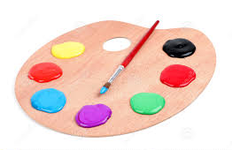
The Palette-WL Algorithm
Palette-WL, uses a hashing function with a normalization term
Still a perfect hashing; and becomes color-order preserving.
Figure from the Internet
Notes:
The proposed palette-WL uses a hashing function similar to the hashing-WL, except for adding a normalization term. We can prove that it is still a perfect hashing, and additionaly becomes color-order preserving. Using this normalized hash function, we can also rigorously prove the convergence of the colors. And again, I‘ll skip the details. We call it \textsc{Palette-WL} because the labeling process is like to draw initial colors from a palette to vertices, and then iteratively refine them by mixing their original colors and nearby colors in such a way that the colors' relative ordering is preserved.

Slide 23
Encoding into Adjacency Matrix
Overall framework:
4
0 | 1 | 1 | 1
1 | 0 | 1 | 1
1 | 1 | 0 | 0
1 | 1 | 0 | 0
B
A
2
1
1
B
A
Extract
subgraphs
Graph
labeling
3
Data
encoding
Neural
network
C
0 | 0 | 1 | 0
0 | 0 | 1 | 1
1 | 1 | 0 | 0
0 | 1 | 0 | 0
D
C
4
2
0
D
1
3
Notes:
After determining the node labels, finally, we encode each enclosing subgraph into an adjacency matrix and feed it into a neural network.

Slide 24
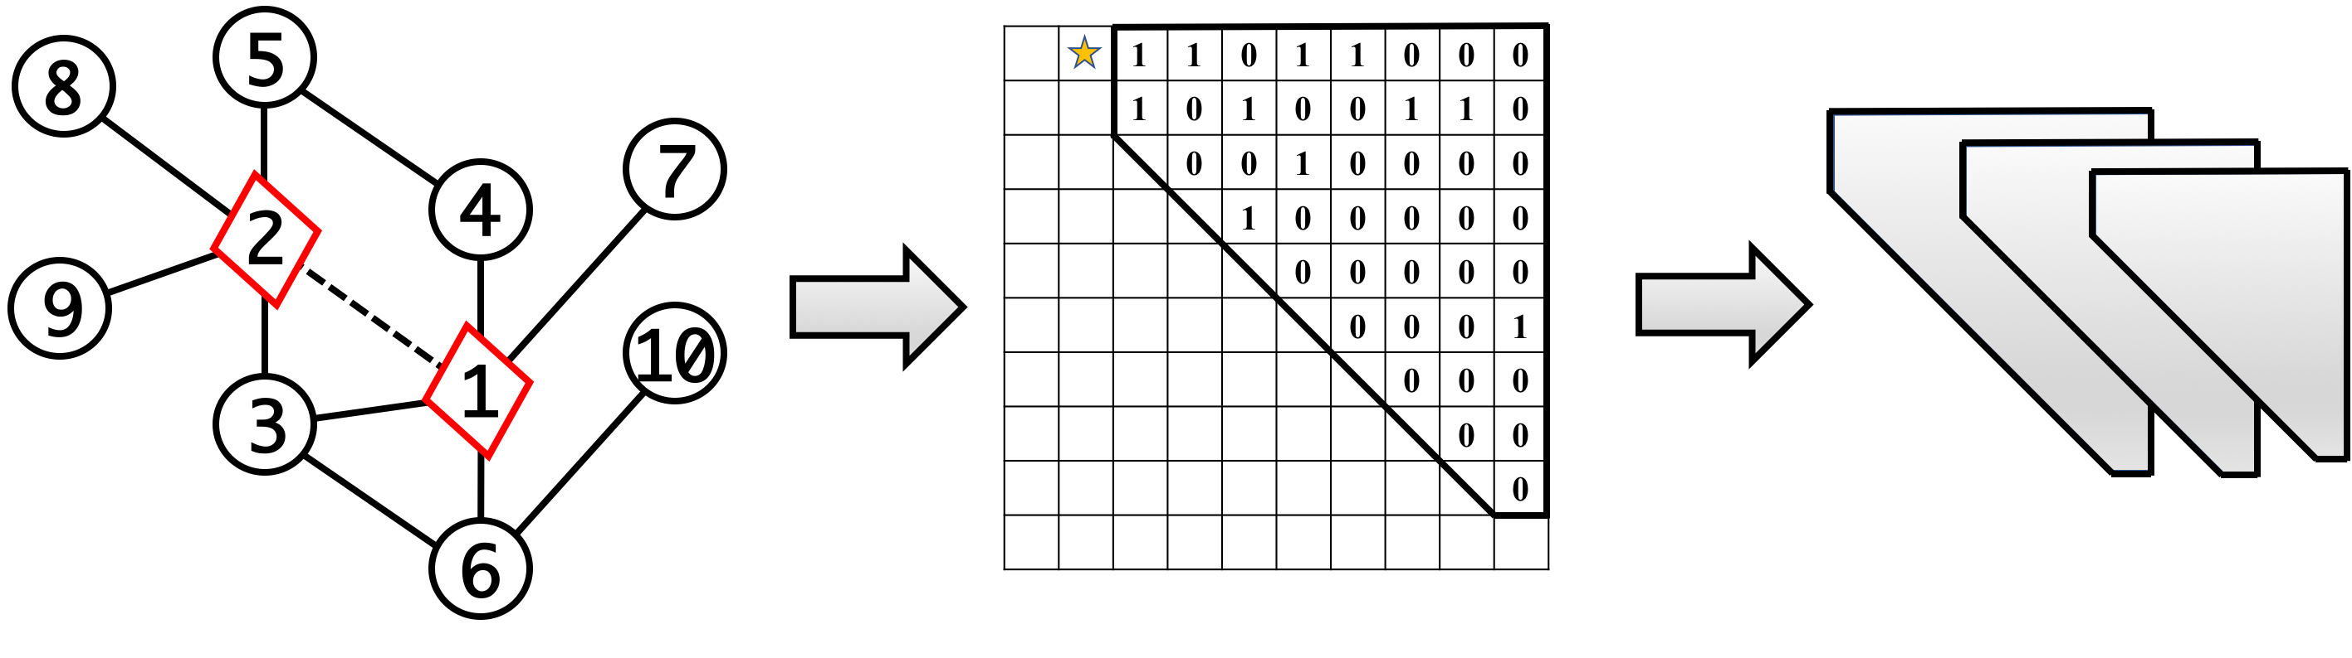
Encoding into Adjacency Matrix
Construct adjacency matrix using the converged WL colors
NN architecture
Three fully-connected hidden layers with 32, 32, 16 hidden neurons.
ReLU nonlinearity.
Notes:
Given the converged WL colors, we can determine the vertex order based on these colors and construct an adjacency matrix. We can see that, because of the color-order preserving property of palette-WL, the two target nodes will always have the smallest final colors in the end. So this guarantees that the target link is always encoded in A12 of the adjacency matrix shown as the yellow star here. This is important, since otherwise this yellow star may appear arbitrarily in the adjacency matrix, so that neural networks cannot distinguish which is target link to predict.
After the encoding, this upper-triangular adjacency matrix is vertically fed into a three layer fully connected neural network to train a link prediction model.

Slide 25
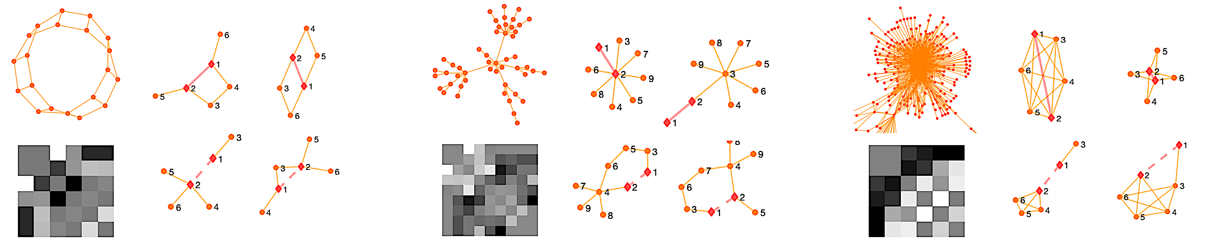
Visualization Experiments
The 3-regular network
Two most frequent positive
enclosing subgraphs
Two random negative samples
Weights
Notes:
We did some visualization experiments to show the learned features and the extracted enclosing subgraphs for some toy networks. The upperleft is a 3-regular network, the bottom left is the learned weights. Beside them, the first row shows two most frequent positive enclosing subgraphs. And the second row shows two random negative samples. As we can see, the proposed method successfully extracts the building blocks of the network, and the weights show some patterns about how a link is likely to form in this network.

Slide 26
Visualization Experiments
A preferential-attachment
network
Two most frequent positive
enclosing subgraphs
Weights
Two random negative samples
Notes:
This is another example for a preferential attachment network. We can also see that the extracted enclosing subgraphs successfully illustrate the tendency to connect to popular nodes.

Slide 27
Visualization Experiments
The US-Air network
Two most frequent positive
enclosing subgraphs
Two random negative samples
Weights
Notes:
We also did the visualization experiment on the US air line network. This result is also interesting. The most frequent positive enclosing subgraph is a clique. This makes sense since big cities have more airlines than small cities and big cities tend to establish dense connections with other big cities. So this results in many cliques in the US air line networks. And our method successfully extracts these patterns.

Slide 28
WLNM vs Heuristic Methods
Dataset | CN | Jaccard | AA | RA | PA | Katz | RD | PR | SR | SBM | MF-c | MF-r | WLNM (K=10)
USAir | 0.94 | 0.903 | 0.95 | 0.956 | 0.894 | 0.931 | 0.898 | 0.944 | 0.782 | 0.944 | 0.918 | 0.849 | 0.958
NS | 0.938 | 0.938 | 0.938 | 0.938 | 0.682 | 0.94 | 0.582 | 0.94 | 0.94 | 0.92 | 0.636 | 0.72 | 0.984
PB | 0.919 | 0.873 | 0.922 | 0.923 | 0.901 | 0.928 | 0.883 | 0.935 | 0.773 | 0.938 | 0.93 | 0.943 | 0.933
Yeast | 0.891 | 0.89 | 0.891 | 0.892 | 0.824 | 0.921 | 0.88 | 0.927 | 0.914 | 0.914 | 0.831 | 0.881 | 0.956
C.ele | 0.848 | 0.792 | 0.864 | 0.868 | 0.755 | 0.864 | 0.74 | 0.901 | 0.76 | 0.867 | 0.832 | 0.844 | 0.859
Power | 0.59 | 0.59 | 0.59 | 0.59 | 0.441 | 0.657 | 0.845 | 0.664 | 0.763 | 0.665 | 0.524 | 0.517 | 0.848
Router | 0.561 | 0.561 | 0.561 | 0.561 | 0.471 | 0.378 | 0.926 | 0.38 | 0.367 | 0.857 | 0.779 | 0.783 | 0.944
E.coli | 0.932 | 0.806 | 0.952 | 0.958 | 0.912 | 0.929 | 0.889 | 0.954 | 0.637 | 0.939 | 0.909 | 0.916 | 0.971
Best results in red.
Observations:
WLNM outperforms all baselines on 6 out of 8 datasets.
WLNM performs very well on Power and Router, on which few existing heuristics can perform significantly better than random guess.
Notes:
For the performance experiments, we compare WLNM with 13 baselines methods, including 9 popular heuristic methods and 3 latent-feature models. Our method outperforms all the baselines on 6 out of 8 benchmark datasets.(翻页) These baselines include common neighbors, Jaccard index, Adamic-Adar, Katz index, resistance distance, pagerank, simrank, statistical block model, matrix-factorization and so on. Moreover, for the Power and Router networks, where few existing heuristic scores can perform significantly better than random guess, our method can perform very well on these two networks. This is because WLNM does not assume some certain link formation mechanisms such as common neighbors, but learns these mechanisms from the network itself, so it is able to learn some new suitable heuristics for different networks.

Slide 29
WLNM vs WLLR
Dataset | WLLR | WLNM
USAir | 0.896 | 0.958
NS | 0.862 | 0.984
PB | 0.827 | 0.933
Yeast | 0.854 | 0.956
C.ele | 0.803 | 0.859
Power | 0.778 | 0.848
Router | 0.897 | 0.944
E.coli | 0.894 | 0.971
Best results in red.
WLLR: train logistic regression models on the adjacency matrices instead of neural networks.
Observations:
WLNM outperforms WLLR on all datasets.
Deep neural networks can learn more complex topological patterns which foster the formation of links.
Notes:
Next we replace the neural network in WLNM with a logistic regression model. As we can see, the performance degrades a lot. This proves the importance of neural networks to learn complex and nonlinear topological patterns which foster the formation of links.

Slide 30
Palette-WL vs Other Graph Labelings
Dataset | Palette-WL | Hashing-WL | Nauty | Random
USAir | 0.958 | 0.758 | 0.767 | 0.607
NS | 0.984 | 0.881 | 0.896 | 0.738
PB | 0.933 | 0.726 | 0.725 | 0.609
Yeast | 0.956 | 0.743 | 0.764 | 0.654
C.ele | 0.859 | 0.634 | 0.631 | 0.555
Power | 0.848 | 0.665 | 0.641 | 0.55
Router | 0.944 | 0.622 | 0.555 | 0.64
E.coli | 0.971 | 0.857 | 0.838 | 0.773
Best results in red.
Nauty: a graph canonization
software that outputs canonical labeling.
Observations:
Palette-WL achieves the best results among all graph labelings.
Hashing-WL is much worse since it is not color order-preserving.
Canonical labeling (Nauty) and random labeling are not comparable.
Notes:
We also compare palette-WL with several other graph labeling methods. As we can see, the palette-WL performs significantly better than other methods, including the hashing-WL, canonical labeling, and random labeling. The original hashing WL is not comparable with palette-wl, since it cannot preserve the color order between iterations and lead to chaotic final orders. This again validates the importance of palette-WL in subgraph encoding.

Slide 31
Conclusions
Instead of using heuristic scores, WLNM automatically learns graph features for link prediction from links’ enclosing subgraphs.
A color-order preserving hashing-based WL, called Palette-WL, to impose the vertex ordering.
Outperform all heuristic methods on most benchmark datasets.
Perform very well on networks where few existing heuristics can do well.
A next-generation link prediction method, state-of-the-art performance, universality across different networks.
Notes:
In this work, we proposed WLNM which automatically learns graph features for link prediction from links’ enclosing subgraphs instead of using the heuristic scores.
We developed a graph labeling method, palette-WL, to impose vertex orderings, which meets the special requirements of encoding enclosing subgraphs.
Experiment results show that our method not only outperforms all the heuristic methods on most benchmark datasets, but also performs very well on the two networks where few existing heuristic can work well.
In summery, WLNM is a next generation link prediction method, with new state-of-art performance and universal applicability across different networks.

Slide 32
Thanks! Questions?
Acknowledgments:
This work is supported in part by the DBI-1356669, SCH-1343896, III-1526012, and SCH-1622678 grants from the National Science Foundation of the United States.

